Slide 1
JAL1301 DATA SCIENCE USING PYTHON
UNIT V DATA VISUALIZATION

Slide 2
UNIT V DATA VISUALIZATION
SYLLABUS
Importing Matplotlib – Line plots – Scatter plots – Visualizing errors – Density and contour plots – Histograms – Plot legends – Colors – Subplots – Text and annotation – Customization – Three-dimensional plotting - Geographic Data with Basemap - Visualization with Seaborn.

Slide 3
Importing Matplotlib
Matplotlib is a multiplatform data visualization library built on NumPy arrays, and designed to work with the broader SciPy stack.
Has the ability to play well with many operating systems and graphics backends.
Supports dozens of backends and output types.
To use it in a Python program, import it:
import matplotlib as mpl
import matplotlib.pyplot as plt

Slide 4
Importing Matplotlib
To choose appropriate aesthetic styles for the figures:
Other styles available:
https://www.dunderdata.com/blog/view-all-available-matplotlib-styles
To Plot y versus x as lines and/or markers.
To view the Matplotlib plots:
Should be used only once per Python session, and is most often seen at the very end of the script.
plt.style.use('classic')
plt.plot(x, y)
plt.show( )

Slide 5
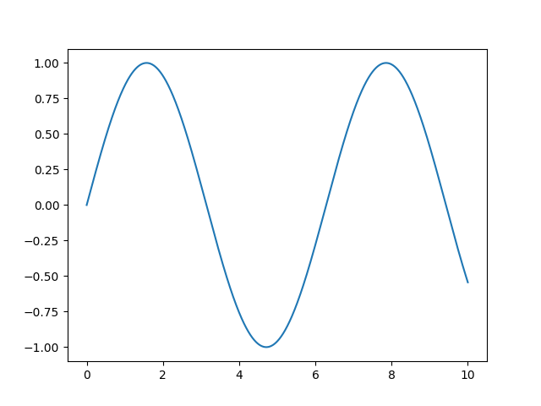
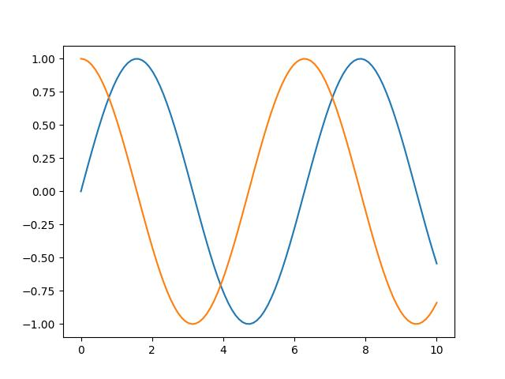
Importing Matplotlib
Example plots:
import matplotlib.pyplot as plt
import numpy as np
x = np.linspace(0, 10, 100)
plt.plot(x, np.sin(x))
plt.show()
import matplotlib.pyplot as plt
import numpy as np
x = np.linspace(0, 10, 100)
plt.plot(x, np.sin(x))
plt.plot(x, np.cos(x))
plt.show()

Slide 6
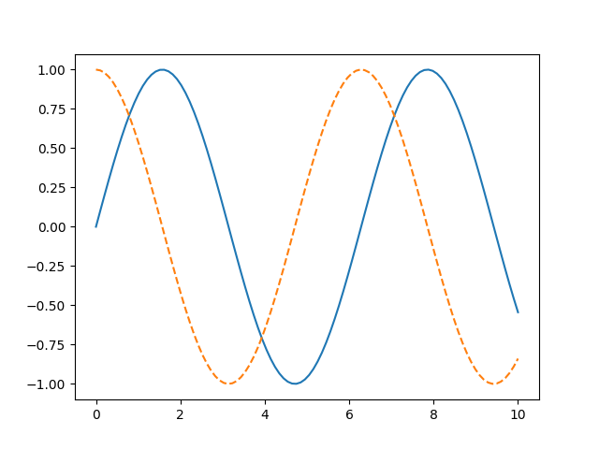
Importing Matplotlib
An example: to save the plot generated
import matplotlib.pyplot as plt
import numpy as np
x = np.linspace(0, 10, 100)
fig = plt.figure()
fig.savefig('my_figure.png')
plt.plot(x, np.sin(x), '-')
plt.plot(x, np.cos(x), '--')
plt.show()

Slide 7
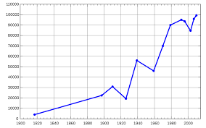
Line Plots
plt.figure( )
plt.axes( )
ax.plot( )
plt.plot( )
plt.show( )
plt.xlim( )
plt.ylim( )
plt.axis( )
plt.title( )
plt.xlabel( )
plt.ylabel( )
plt.legend( )
plt.show( )

Slide 8
Line Plots
The simplest of all plots is the visualization of a single function y = f (x).
A figure and axes can be created:
In Matplotlib, the figure (an instance of the class plt.Figure): a single container that contains all the objects representing axes, graphics, text, and labels.
The axes (an instance of the class plt.Axes): a bounding box with ticks and labels, which will eventually contain the plot elements that make up our visualization.
fig = plt.figure()
ax = plt.axes()

Slide 9
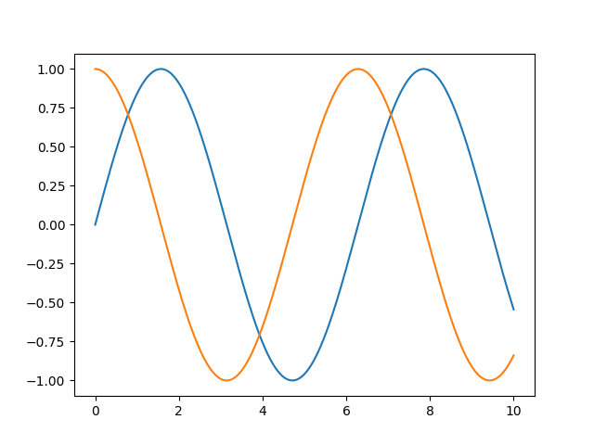
Line Plots
An example: A simple sinusoid
import matplotlib.pyplot as plt
import numpy as np
fig = plt.figure()
ax = plt.axes()
x = np.linspace(0, 10, 1000)
ax.plot(x, np.sin(x)); # blue line
plt.plot(x, np.cos(x)) #orange
plt.show()

Slide 10
Line Plots - Adjusting the Plot: Line Colors and Styles
To control the line colors and styles. The plt.plot() function takes additional arguments that can be used to specify these.
The line color can be specified in a variety of ways using the ‘color’ keyword: RGB (Red/Green/Blue) and CMYK (Cyan /Magenta/ Yellow/ blacK)
plt.plot(x, np.sin(x), color='blue') # specify color by name
plt.plot(x, np.sin(x), color='g') # short color code (rgbcmyk)
plt.plot(x, np.sin(x), color='0.75') # Grayscale between 0 and 1
plt.plot(x, np.sin(x), color='#FFDD44') # Hex code (RRGGBB from 00 to FF)
plt.plot(x, np.sin(x), color=(1.0,0.2,0.3)) # RGB tuple, values 0 and 1
plt.plot(x, np.sin(x), color='chartreuse'); # all HTML color names supported

Slide 11
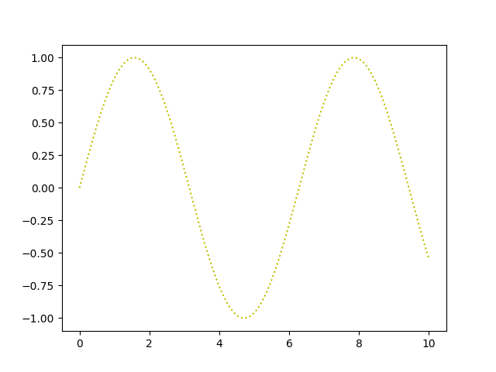
Line Plots - Adjusting the Plot: Line Colors and Styles
The line style of a line plot can be adjusted using the ‘linestyle’ keyword
plt.plot(x, np.sin(x), linestyle='solid')
plt.plot(x, np.sin(x), linestyle='dashed')
plt.plot(x, np.sin(x), linestyle='dashdot')
plt.plot(x, np.sin(x), linestyle='dotted');
# For short, the following codes can be used:
plt.plot(x, np.sin(x), linestyle='-') # solid
plt.plot(x, np.sin(x), linestyle='--') # dashed
plt.plot(x, np.sin(x), linestyle='-.') # dashdot
plt.plot(x, np.sin(x), linestyle=':'); # dotted

Slide 12
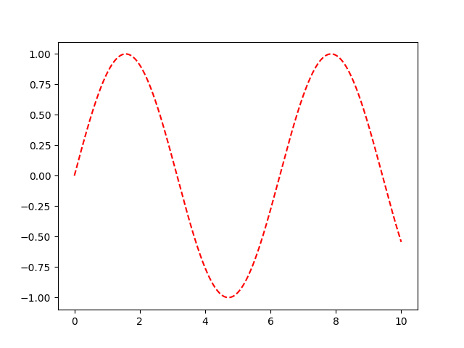
Line Plots - Adjusting the Plot: Line Colors and Styles
The color and line style of a line plot can be combined as below
import matplotlib.pyplot as plt
import numpy as np
x = np.linspace(0, 10, 1000)
plt.plot(x, np.sin(x), '--r')
plt.show()

Slide 13
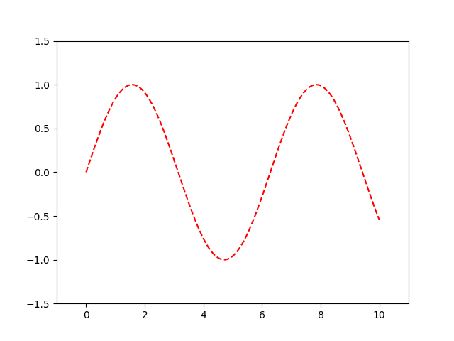
Line Plots - Adjusting the Plot: Axes Limits
Matplotlib chooses default axes limits for a plot
But to have finer control, the most basic way to adjust axis limits is to use the plt.xlim() and plt.ylim() methods
import matplotlib.pyplot as plt
import numpy as np
x = np.linspace(0, 10, 1000)
plt.xlim(-1, 11)
plt.ylim(-1.5, 1.5);
plt.plot(x, np.sin(x), '--r')
plt.show()

Slide 14
Line Plots - Adjusting the Plot: Axes Limits
Instead of using plt.xlim() and plt.ylim() methods, the plt.axis() method allows to set the x and y limits with a single call, by passing a list that specifies [xmin, xmax, ymin, ymax]
import matplotlib.pyplot as plt
import numpy as np
x = np.linspace(0, 10, 1000)
plt.axis([-1, 11, -1.5, 1.5])
plt.plot(x, np.sin(x), '--r')
plt.show()

Slide 15
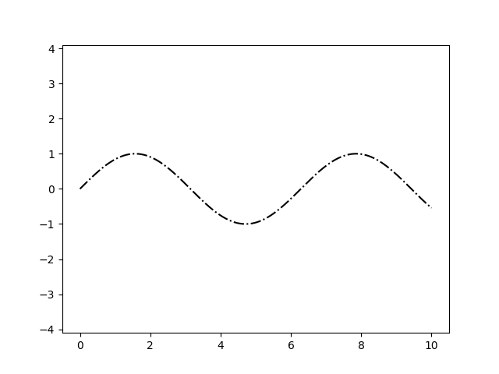
Line Plots - Adjusting the Plot: Axes Limits
To set axis as one unit in x is equal to one unit in y, use ‘equal’ keyword in plt.axis()
import matplotlib.pyplot as plt
import numpy as np
x = np.linspace(0, 10, 1000)
plt.axis(‘equal’)
plt.plot(x, np.sin(x), ‘-.k')
plt.show()

Slide 16
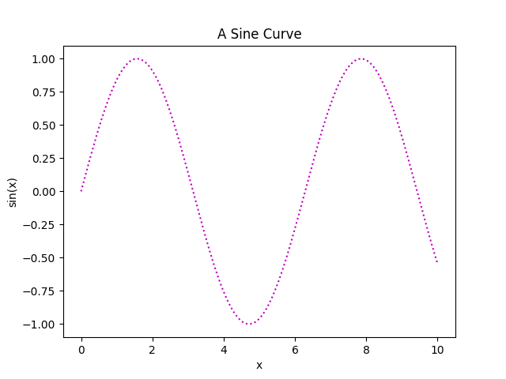
Line Plots - Labeling Plots
Titles and axis labels are the simplest such labels – method that can be used to quickly set them plt.title( ), plt.xlabel( ) and plt.ylabel( );
import matplotlib.pyplot as plt
import numpy as np
x = np.linspace(0, 10, 1000)
plt.title("A Sine Curve")
plt.xlabel("x")
plt.ylabel("sin(x)");
plt.plot(x, np.sin(x), ':m')
plt.show()

Slide 17
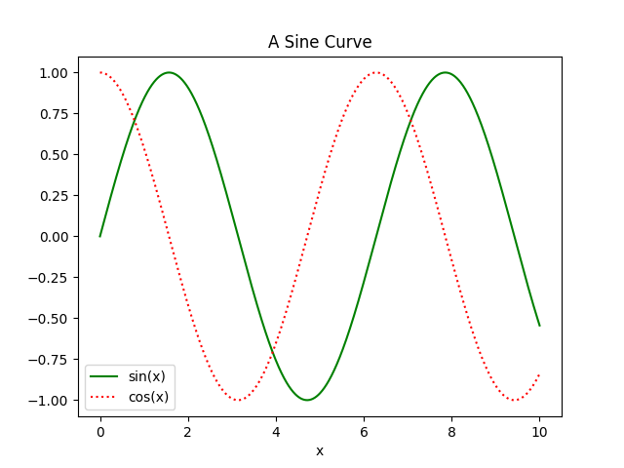
Line Plots - Labeling the Plots
When multiple lines are being shown within a single axes, it can be useful to create a plot legend that labels each line type using plt.legend() method → it keeps track of the line style and color, and matches these with the correct label.
import matplotlib.pyplot as plt
import numpy as np
x = np.linspace(0, 10, 1000)
plt.title("A Sine Curve")
plt.xlabel("x")
plt.plot(x, np.sin(x), '-g', label = 'sin(x)')
plt.plot(x, np.cos(x), ':r', label = 'cos(x)')
plt.legend()
plt.show()

Slide 18
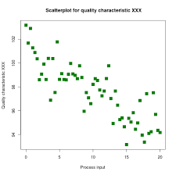
Scatter Plots
plt.plot( )
plt.scatter( )
plt.colorbar( )

Slide 19
scatter Plots
Similar to line plots.
Instead of points being joined by line segments, here the points are represented individually with a dot, circle, or other shape
Import the following functions:
Scatter plots can be produced using the 2 methods: plt.plot() and plt.scatter()
import numpy as np
import matplotlib.pyplot as plt
plt.style.use('seaborn-whitegrid')

Slide 20
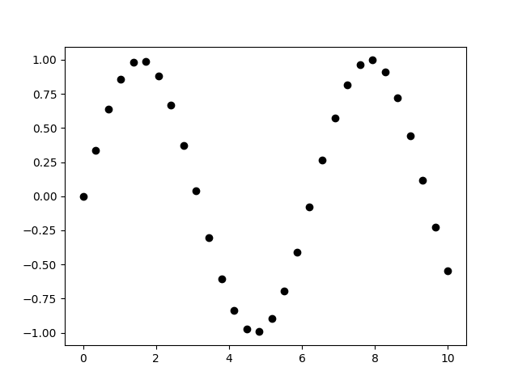
Scatter Plots with plt.plot
plt.plot used to produce line plots can produce scatter plots as well
The 3rd parameter → character that represents the type of symbol used for the plotting.
Instead of ‘o’, other markers that can be used are . , x + v ^ < > s d
import matplotlib.pyplot as plt
import numpy as np
x = np.linspace(0, 10, 30)
plt.plot(x, np.sin(x), 'o', color='k')
plt.show()

Slide 21
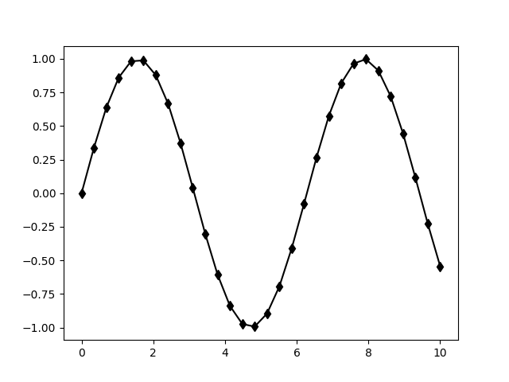
Scatter Plots with plt.plot
These character codes can be used together with line and color codes to plot points along with a line connecting them
Eg.
plt.plot(x, np.sin(x), '-dk')
import matplotlib.pyplot as plt
import numpy as np
x = np.linspace(0, 10, 30)
plt.plot(x, np.sin(x), '-dk')
plt.show()

Slide 22
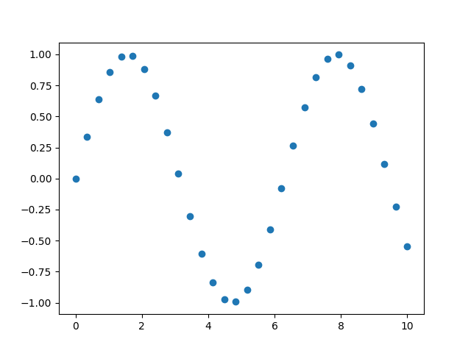
Scatter Plots with plt.scatter
plt.scatter function can be used very similarly to the plt.plot function.
The primary difference of plt.scatter from plt.plot → it can be used to create scatter plots where the properties of each individual point (size, face color, edge color, etc.) can be individually controlled or mapped to data.
import matplotlib.pyplot as plt
import numpy as np
x = np.linspace(0, 10, 30)
plt.scatter(x, np.sin(x), marker='o')
plt.show()

Slide 23
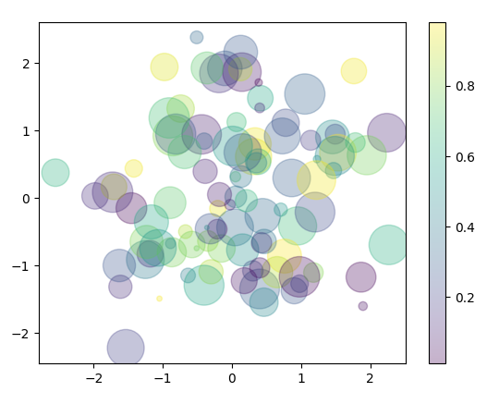
Scatter Plots with plt.scatter
Color argument is automatically mapped to a color scale (shown here by the colorbar() command), and the size argument is given in pixels.
import matplotlib.pyplot as plt
import numpy as np
rng = np.random.RandomState(0)
x = rng.randn(100)
y = rng.randn(100)
colors = rng.rand(100)
sizes = 1000 * rng.rand(100)
plt.scatter(x, y, c=colors, alpha=0.3, s=sizes)
plt.colorbar()
plt.show()

Slide 24
Scatter Plots with plt.scatter
Scatter plot for a dataset (like Iris) can be produced
import matplotlib.pyplot as plt
import numpy as np
from sklearn.datasets import load_iris
iris = load_iris()
features = iris.data.T
plt.scatter(features[0], features[1], alpha=0.2,
s=100*features[3], c=iris.target, cmap='viridis')
plt.xlabel(iris.feature_names[0])
plt.ylabel(iris.feature_names[1])
plt.show()

Slide 25
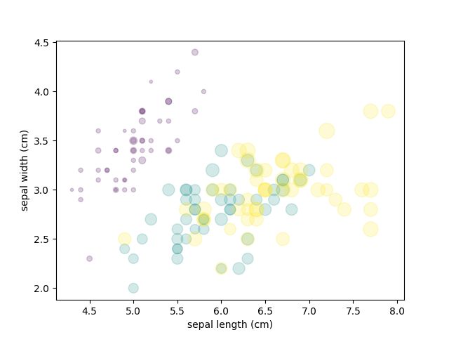
Scatter Plots with plt.scatter
Scatter plot for a dataset (like Iris) can be produced
A colormap (or color map) in the context of data visualization refers to the mapping of numerical values to colors - a set of colors arranged in a gradient that represents the range of values in a dataset
Other colormaps available: plasma, inferno, magma, cividis, jet, coolwarm, greys, rainbow, Blues, Reds

Slide 26
Plt.Plot vs plt.scatter
plt.plot - noticeably more efficient and it should be preferred over plt.scatter for large datasets.
plt.scatter has the capability to render a different size and/or color for each point, so the renderer must do the extra work of constructing each point individually
plt.plot - the points are always essentially clones of each other, so the work of determining the appearance of the points is done only once for the entire set of data.

Slide 27
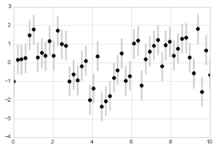
visualizing errors
Basic errorbars
  plt.errorbar( )
continuous errors
  plt.fill_between( )

Slide 28
visualizing errors
For any scientific measurement, both of the following are important:
    accurate reporting of the number itself
    accurate accounting for errors
Error → difference between expected value and obtained / observed value.
So usually, a value ‘a’ is expressed as a ± d, where d represents the uncertainty or variability associated with each data point.
For eg. if expected value = 75 ± 5, the obtained value can be 72 ± 4
In visualization of data and results, showing these errors effectively can make a plot convey much more complete information.

Slide 29
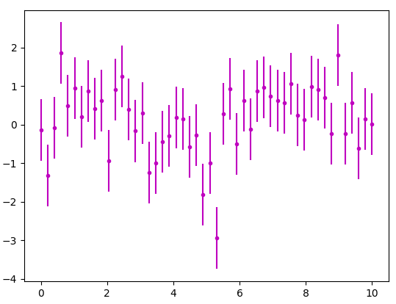
Basic error bars
Initial import statements to generate a plot:
A basic errorbar with vertical errorbars can be created with a single Matplotlib function call
import numpy as np
import matplotlib.pyplot as plt
plt.style.use('seaborn-whitegrid')
x = np.linspace(0, 10, 50)
dy = 0.8
y = np.sin(x) + dy * np.random.randn(50)
plt.errorbar(x, y, yerr = dy, fmt = '.m')
plt.show()
randn → generates random numbers from a standard normal distribution
fmt → format → for controlling the appearance of lines and points
dy → the associated uncertainty or error

Slide 30
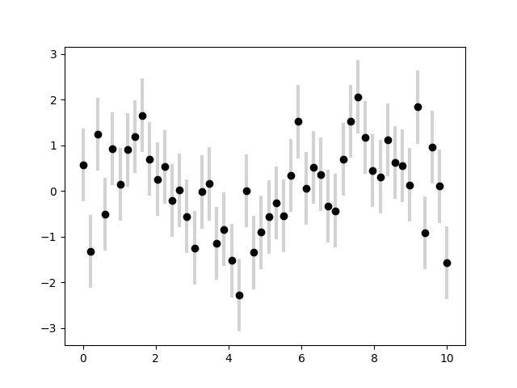
Basic error bars
errorbar function has many options to finetune the outputs.
Helpful in crowded plots, to make the errorbars lighter than the points themselves
x = np.linspace(0, 10, 50)
dy = 0.8
y = np.sin(x) + dy * np.random.randn(50)
plt.errorbar(x, y, yerr=dy, fmt='o', color='black', ecolor='lightgray', elinewidth=3, capsize=0)
plt.show()

Slide 31
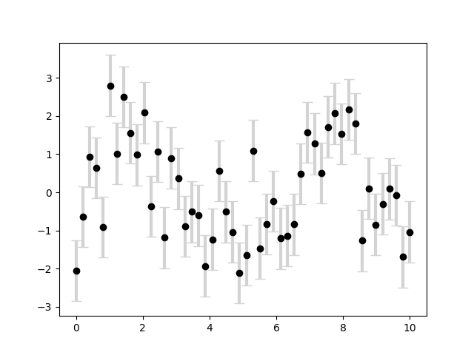
Basic error bars
errorbar function has many options to finetune the outputs.
Helpful in crowded plots, to make the errorbars lighter than the points themselves
x = np.linspace(0, 10, 50)
dy = 0.8
y = np.sin(x) + dy * np.random.randn(50)
plt.errorbar(x, y, yerr=dy, fmt='o', color='black', ecolor='lightgray', elinewidth=3, capsize=5)
plt.show()

Slide 32
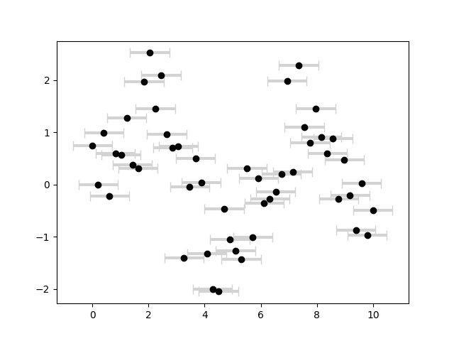
Basic error bars
errorbar function has many options to finetune the outputs.
Helpful in crowded plots, to make the errorbars lighter than the points themselves
x = np.linspace(0, 10, 50)
dx = 0.7
y = np.sin(x) + dx*np.random.randn(50)
plt.errorbar(x, y, xerr=dx, fmt='o', color='black', ecolor='lightgray', elinewidth=3, capsize=5)
plt.show()

Slide 33
continuous errors
Errorbars may have to be shown on continuous quantities – over a line plot
x = np.linspace(0, 10, 50)
dx = 0.7
y = np.sin(x)
error = 0.2
plt.errorbar(x, y, yerr=error, fmt='-', color='b', ecolor='lightgray', capsize=3)
plt.xlabel('X-axis')
plt.ylabel('Y-axis')
plt.title('Line Plot with Continuous Errors')
plt.show()

Slide 34
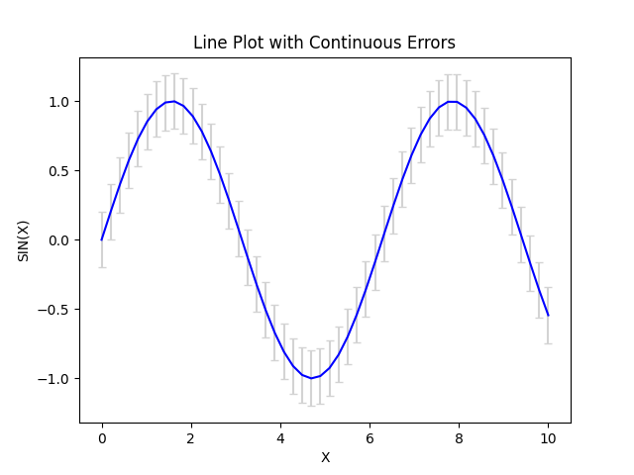
continuous errors
Errorbars may have to be shown on continuous quantities – over a line plot
x = np.linspace(0, 10, 50)
dx = 0.7
y = np.sin(x)
error = 0.2
plt.errorbar(x, y, yerr=error, fmt='-', color='b', ecolor='lightgray', capsize=3)
plt.xlabel('X-axis')
plt.ylabel('Y-axis')
plt.title('Line Plot with Continuous Errors')
plt.show()

Slide 35
continuous errors
Errorbars may have to be shown on continuous quantities over a line plot → no built-in convenience routine for this
It can be done by combining primitives like plt.plot and plt.fill_between for a useful result.
x = np.linspace(0, 10, 50)
dx = 0.7
y = np.sin(x)
error = 0.2
plt.plot(x, y, label='Function')
plt.fill_between(x, y - error, y + error, color='skyblue', alpha=0.3, label='Error Band')
plt.xlabel('X')
plt.ylabel(‘SIN(X)')
plt.title('Line Plot with Continuous Errors')
plt.show()

Slide 36
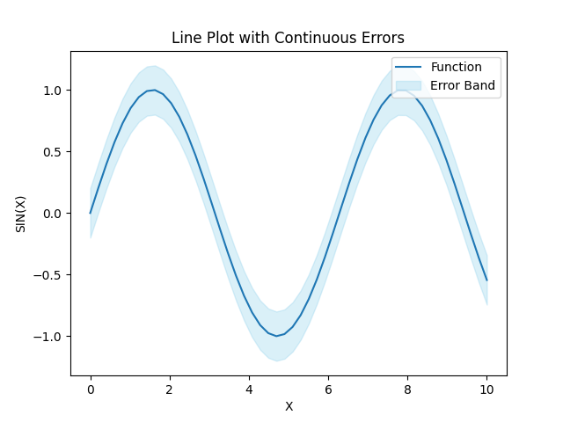
continuous errors
Errorbars may have to be shown on continuous quantities over a line plot → no built-in convenience routine for this
It can be done by combining primitives like plt.plot and plt.fill_between for a useful result.

Slide 37
continuous errors
plt.fill_between function ➔ we pass an x value, then the lower y-bound, then the upper y-bound, and the result is that the area between these regions is filled.
This method can be used to model the errors in any data distributions like Gaussian distributions, Poisson distribution, Normal distribution, etc.

Slide 38
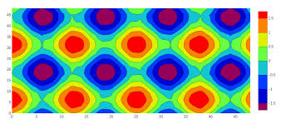
Density and contour plots
np.meshgrid( )
plt.contour( )
plt.contourf( )
plt.imshow()

Slide 39
Density and contour plots
Used to display three-dimensional data in two dimensions using contours or color-coded regions.
Three Matplotlib functions used:
  plt.contour for contour plots,
  plt.contourf for filled contour plots, and
  plt.imshow for showing images
Initial import statements:
import numpy as np
import matplotlib.pyplot as plt
plt.style.use('seaborn-whitegrid')

Slide 40
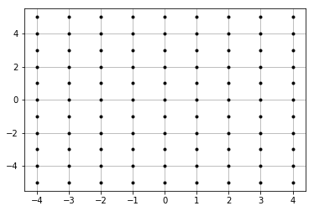
Visualizing a Three-Dimensional Function
Consider the function z = f (x, y)
A contour plot can be created with the plt.contour function.
It takes three arguments: a grid of x values, a grid of y values, and a grid of z values.
np.meshgrid function → builds two-dimensional grids from one-dimensional arrays:

Slide 41
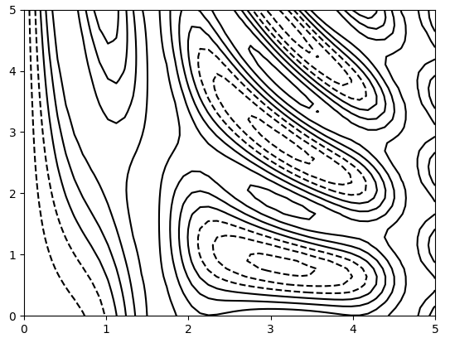
Visualizing a Three-Dimensional Function
Using plt.contour function
Dashed lines → -ve values, solid lines → +ve values.
Single color or colormap can be used
import matplotlib.pyplot as plt
import numpy as np
def f(x, y):
return np.sin(x) ** 10 + np.cos(10 + y * x) * np.cos(x)
x = np.linspace(0, 5, 50)
y = np.linspace(0, 5, 40)
X, Y = np.meshgrid(x, y)
Z = f(X, Y)
plt.contour(X, Y, Z, colors='black')
plt.show()

Slide 42
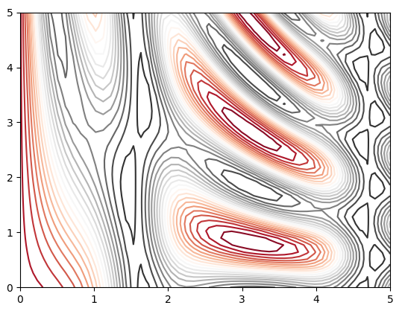
Visualizing a Three-Dimensional Function
Using plt.contour function
Using colormap, eg. RdGr (Red-Gray) colormap
import matplotlib.pyplot as plt
import numpy as np
def f(x, y):
return np.sin(x) ** 10 + np.cos(10 + y * x) * np.cos(x)
x = np.linspace(0, 5, 50)
y = np.linspace(0, 5, 40)
X, Y = np.meshgrid(x, y)
Z = f(X, Y)
plt. contour(X, Y, Z, 20, cmap='RdGy')
plt.show()

Slide 43
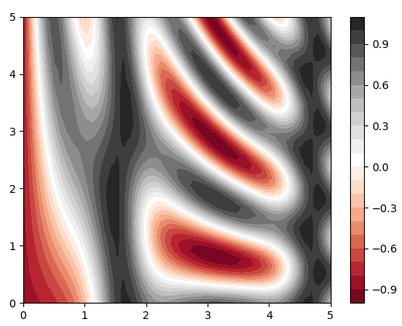
Visualizing a Three-Dimensional Function
Using plt.contourf function
The spaces between the lines may be filled using this function
Gives a peak – valley appearance
import matplotlib.pyplot as plt
import numpy as np
def f(x, y):
return np.sin(x) ** 10 + np.cos(10 + y * x) * np.cos(x)
x = np.linspace(0, 5, 50)
y = np.linspace(0, 5, 40)
X, Y = np.meshgrid(x, y)
Z = f(X, Y)
plt.contourf(X, Y, Z, 20, cmap='RdGy')
plt.colorbar()
plt.show()

Slide 44
Visualizing a Three-Dimensional Function
Using plt.imshow function
Instead of new polygon for each step in the level and filling the color steps continuously
extent [xmin, xmax, ymin, ymax] of the image on the plot → must be specified manually
import matplotlib.pyplot as plt
import numpy as np
def f(x, y):
return np.sin(x) ** 10 + np.cos(10 + y * x) * np.cos(x)
x = np.linspace(0, 5, 50)
y = np.linspace(0, 5, 40)
X, Y = np.meshgrid(x, y)
plt.contourf(X, Y, Z, 20, cmap='RdGy')
plt.colorbar()
plt.imshow(Z, extent=[0, 5, 0, 5], origin='lower', cmap='RdGy')
plt.show()

Slide 45
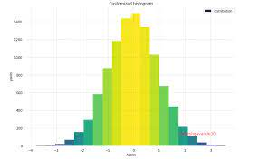
Histograms
plt.hist( )
np.histogram( )
plt.hist2d( )
np.histogram2d( )
plt.hexbin( )

Slide 46
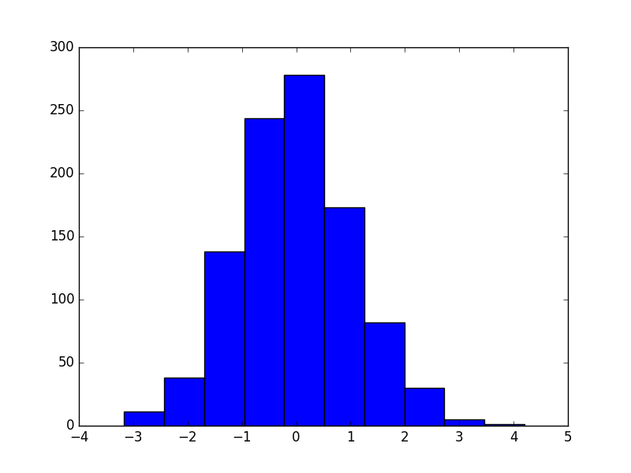
histograms
A simple histogram can be a great first step in understanding a dataset.
Using plt.hist() function – to create a 1-d histogram for the given data
import matplotlib.pyplot as plt
import numpy as np
plt.style.use('classic')
data = np.random.randn(1000)
plt.hist(data)
plt.show()

Slide 47
histograms
The hist() function has many options to tune both the calculation and the display
import matplotlib.pyplot as plt
import numpy as np
plt.style.use('classic')
data = np.random.randn(1000)
plt.hist(data, bins=30, normed=True, alpha=0.5, histtype='stepfilled', color='steelblue', edgecolor='none');
plt.show()

Slide 48
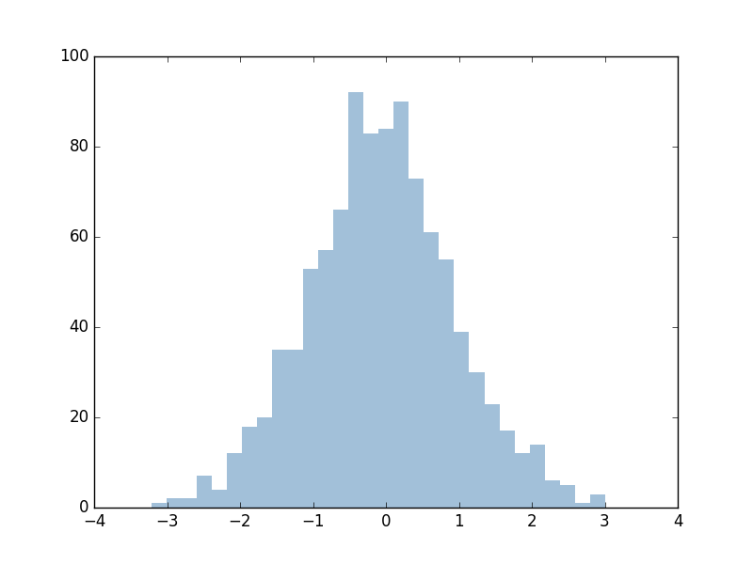
histograms
The hist() function has many options to tune both the calculation and the display
import matplotlib.pyplot as plt
import numpy as np
plt.style.use('classic')
data = np.random.randn(1000)
plt.hist(data, bins=30, normed=True, alpha=0.5, histtype='stepfilled', color='steelblue', edgecolor='none');
plt.show()

Slide 49
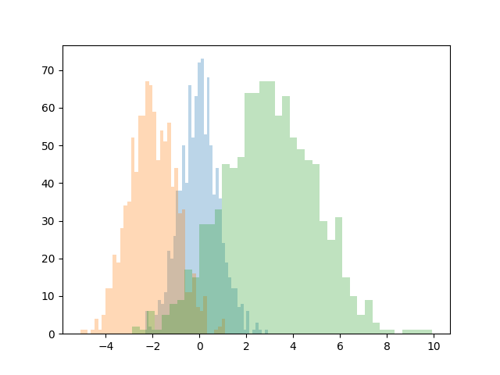
histograms
Parameter ‘alpha’ → used to adjust transparency of the bars
**kwargs → This syntax allows to pass additional keyword arguments to the hist function. These arguments can include parameters like bins, color, alpha, etc., which control the appearance and behavior of the histogram.
import matplotlib.pyplot as plt
import numpy as np
x1 = np.random.normal(0, 0.8, 1000)
x2 = np.random.normal(-2, 1, 1000)
x3 = np.random.normal(3, 2, 1000)
kwargs = dict(histtype='stepfilled', alpha=0.3, bins=40)
plt.hist(x1, **kwargs)
plt.hist(x2, **kwargs)
plt.hist(x3, **kwargs)
plt.show()

Slide 50
histograms
np.histogram() → used if the number of points that would be in a given bin has to be counted
Number of bins can be altered as per user’s need
import numpy as np
data = np.random.randn(1000)
counts, bin_edges = np.histogram(data, bins=5)
print(counts)
OUTPUT:
[ 77 374 435 106 8]

Slide 51
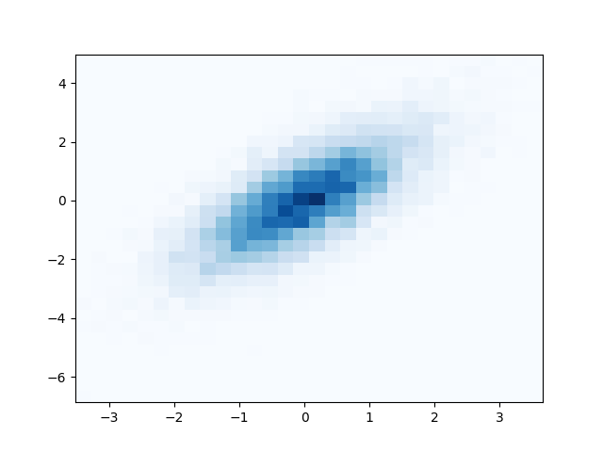
Two-dimensional histograms
histograms in two dimensions can be created by dividing points among two-dimensional bins.
Using plt.hist2d() function
import matplotlib.pyplot as plt
import numpy as np
mean = [0, 0]
cov = [[1, 1], [1, 2]]
x, y = np.random.multivariate_normal(mean, cov, 10000).T
plt.hist2d(x, y, bins=30, cmap='Blues')
plt.show()

Slide 52
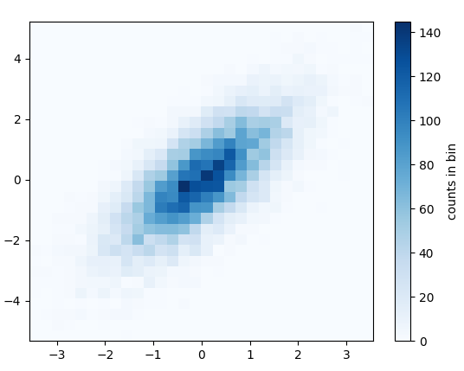
Two-dimensional histograms
Histograms in two dimensions can be created by dividing points among two-dimensional bins.
Using plt.hist2d() function
import matplotlib.pyplot as plt
import numpy as np
mean = [0, 0]
cov = [[1, 1], [1, 2]]
x, y = np.random.multivariate_normal(mean, cov, 10000).T
plt.hist2d(x, y, bins=30, cmap='Blues')
cb = plt.colorbar()
cb.set_label('counts in bin')
plt.show()

Slide 53
Two-dimensional histograms
np.histogram2d() → used if the number of points in a given bin has to be counted
Number of bins can be altered as per user’s need
xedges and yedges – gives the bin edge points
along the x-axis and y-axis
import numpy as np
data = np.random.randn(1000)
counts, xedges, yedges = np.histogram2d(x, y, bins=6)
print(counts)
OUTPUT:
[[ 1. 2. 0. 0. 0. 0.]
[ 1. 6. 2. 0. 0. 0.]
[ 1. 9. 13. 8. 1. 0.]
[ 0. 3. 7. 7. 8. 0.]
[ 0. 0. 6. 9. 7. 1.]
[ 0. 0. 0. 1. 2. 5.]]

Slide 54
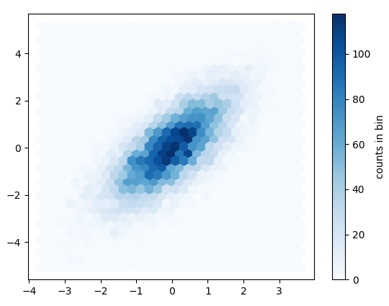
Two-dimensional histograms
Histograms in two dimensions can be created by a two-dimensional dataset binned within a grid of hexagons.
Using plt.hexbin() function
import matplotlib.pyplot as plt
import numpy as np
mean = [0, 0]
cov = [[1, 1], [1, 2]]
x, y = np.random.multivariate_normal(mean, cov, 10000).T
plt.hexbin(x, y, gridsize=30, cmap='Blues')
cb = plt.colorbar(label = 'counts in bin')
plt.show()

Slide 55
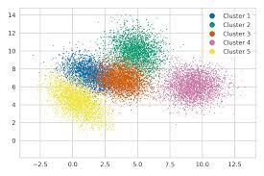
Plot legends
Customizing Plot legends
Choosing Elements for the Legend
Legend for Size of Points
Multiple Legends

Slide 56
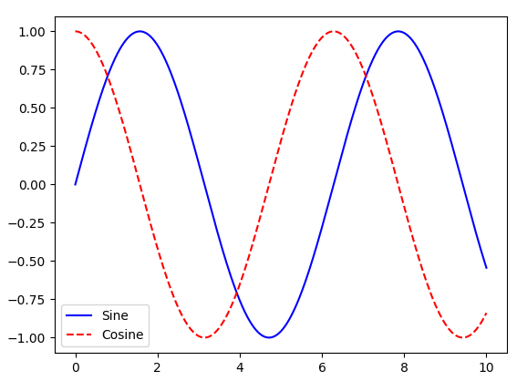
Plot legends
Plot legends → used to give meaning to a visualization by assigning labels to the various plot elements.
The simplest legend can be created with the plt.legend() command, which automatically creates a legend for any labeled plot elements
import matplotlib.pyplot as plt
import numpy as np
x = np.linspace(0, 10, 1000)
plt.plot(x, np.sin(x), '-b', label='Sine')
plt.plot(x, np.cos(x), '--r', label='Cosine')
plt.legend()
plt.show()

Slide 57
Customizing Plot legends
A legend can be customized in location, border shape, etc.
specify the location → using ‘loc’ (‘upper right’, ‘lower left’,
turn off the frame → using ‘frameon’
specify the number of columns in the legend → using ‘ncol’ command
specify a rounded box → using fancybox
add a shadow → using shadow
change the transparency (alpha value) of the frame → using framealpha
change the padding around the text → using borderpad

Slide 58
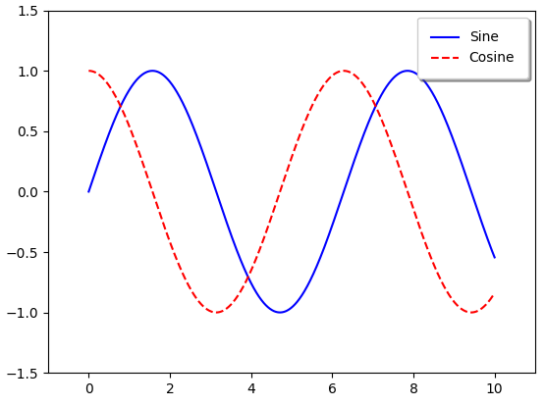
Customizing Plot legends
Customizing a legend:
x = np.linspace(0, 10, 1000)
plt.plot(x, np.sin(x), '-b', label='Sine')
plt.plot(x, np.cos(x), '--r', label='Cosine')
plt.axis([-1, 11, -1.5, 1.5])
plt.legend(loc='upper right', fancybox=True, shadow=True, framealpha=1, borderpad=1)
#plt.legend(frameon=False, loc='lower center', ncol=2)
plt.show()

Slide 59
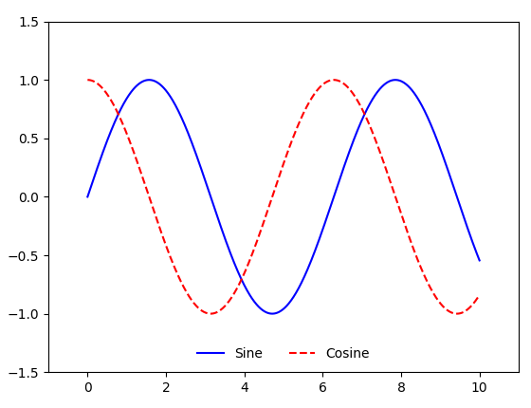
Customizing Plot legends
Customizing a legend:
x = np.linspace(0, 10, 1000)
plt.plot(x, np.sin(x), '-b', label='Sine')
plt.plot(x, np.cos(x), '--r', label='Cosine')
plt.axis([-1, 11, -1.5, 1.5])
#plt.legend(loc='upper right', fancybox=True, shadow=True, framealpha=1, borderpad=1)
plt.legend(frameon=False, loc='lower center', ncol=2)
plt.show()

Slide 60
Choosing Elements for the Legend
Customizing a legend:
x = np.linspace(0, 10, 1000)
plt.plot(x, np.sin(x), '-b', label='Sine')
plt.plot(x, np.cos(x), '--r', label='Cosine')
plt.axis([-1, 11, -1.5, 1.5])
#plt.legend(loc='upper right', fancybox=True, shadow=True, framealpha=1, borderpad=1)
plt.legend(frameon=False, loc='lower center', ncol=2)
plt.show()

Slide 61
Legend for Size of Points
Customizing a legend:
x = np.linspace(0, 10, 1000)
plt.plot(x, np.sin(x), '-b', label='Sine')
plt.plot(x, np.cos(x), '--r', label='Cosine')
plt.axis([-1, 11, -1.5, 1.5])
#plt.legend(loc='upper right', fancybox=True, shadow=True, framealpha=1, borderpad=1)
plt.legend(frameon=False, loc='lower center', ncol=2)
plt.show()

Slide 62
Multiple Legends
Customizing a legend:
x = np.linspace(0, 10, 1000)
plt.plot(x, np.sin(x), '-b', label='Sine')
plt.plot(x, np.cos(x), '--r', label='Cosine')
plt.axis([-1, 11, -1.5, 1.5])
#plt.legend(loc='upper right', fancybox=True, shadow=True, framealpha=1, borderpad=1)
plt.legend(frameon=False, loc='lower center', ncol=2)
plt.show()

Slide 63
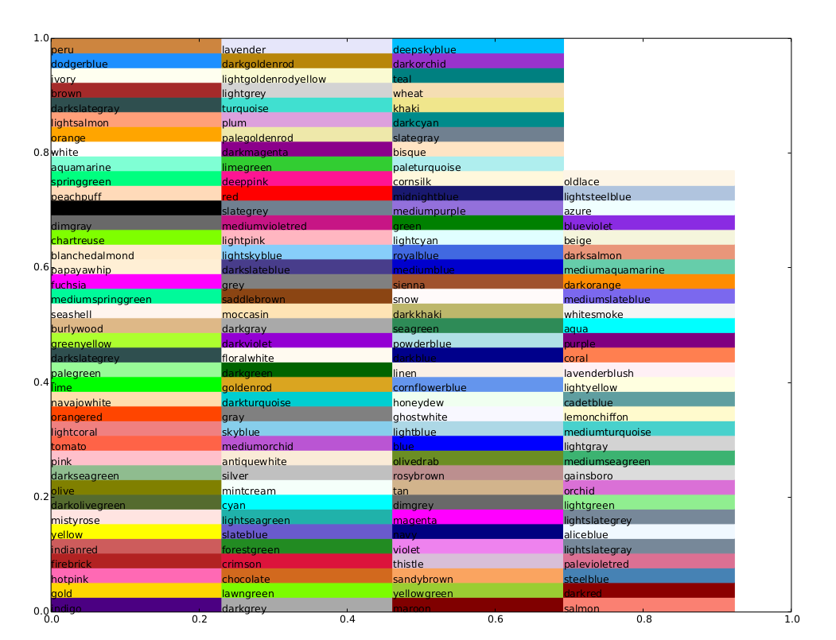
Colors

Slide 64
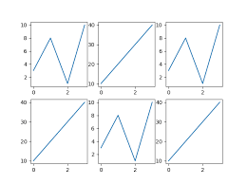
Subplots

Slide 65
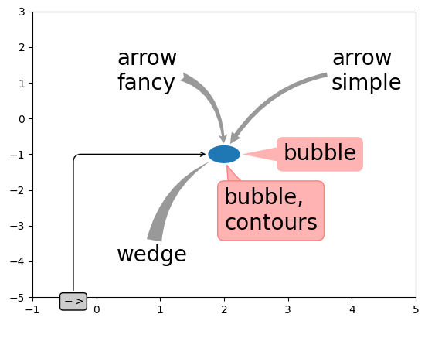
Text and annotation

Slide 66
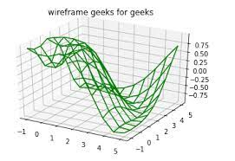
Three-dimensional plotting
plt.axes(projection = ‘3D’)
plt.figure( )
ax.plot3D( )
ax.scatter3D( )
ax.contour3D( )
ax.plot_wireframe( )
np.meshgrid( )
ax.plot_surface(

Slide 67
Three-dimensional plotting
Three-dimensional plots can be created by importing the mplot3d toolkit, included with the main Matplotlib installation
from mpl_toolkits import mplot3d
import numpy as np
import matplotlib.pyplot as plt
fig = plt.figure()
ax = plt.axes(projection='3d')

Slide 68
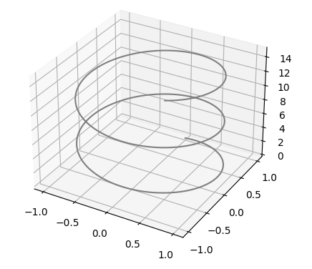
Three-dimensional points and lines
Three-dimensional plots can be created from sets of (x,y, z) triples.
Eg. Data for a three-dimensional line
from mpl_toolkits import mplot3d
import numpy as np
import matplotlib.pyplot as plt
fig = plt.figure()
ax = plt.axes(projection='3d')
zline = np.linspace(0, 15, 1000)
xline = np.sin(zline)
yline = np.cos(zline)
ax.plot3D(xline, yline, zline, 'gray')
plt.show(

Slide 69
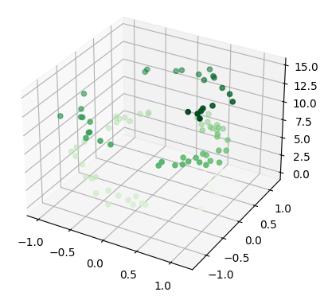
Three-dimensional points and lines
Three-dimensional plots can be created from sets of (x,y, z) triples.
Eg. Data for three-dimensional scattered points
from mpl_toolkits import mplot3d
import numpy as np
import matplotlib.pyplot as plt
fig = plt.figure()
ax = plt.axes(projection='3d')
zdata = 15 * np.random.random(100)
xdata = np.sin(zdata) + 0.1 * np.random.randn(100)
ydata = np.cos(zdata) + 0.1 * np.random.randn(100)
ax.scatter3D(xdata, ydata, zdata, c=zdata, cmap='Greens')
plt.show()

Slide 70
Three-dimensional contour plots
Three-dimensional plots can be created from sets of (x,y, z) triples.
Eg. Data for three-dimensional scattered points
x = np.linspace(-6, 6, 30)
y = np.linspace(-6, 6, 30)
X, Y = np.meshgrid(x, y)
Z = np.sin(np.sqrt(X ** 2 + Y ** 2))
fig = plt.figure()
ax = plt.axes(projection='3d')
ax.contour3D(X, Y, Z, 50, cmap='binary')
ax.set_xlabel('x')
ax.set_ylabel('y')
ax.set_zlabel('z')

Slide 71
Wireframes and Surface Plots
Two other types of three-dimensional plots that work on gridded data are wireframes and surface plots.
These take a grid of values and project it onto the specified three-dimensional surface, and can make the resulting three-dimensional forms quite easy to visualize.

Slide 72
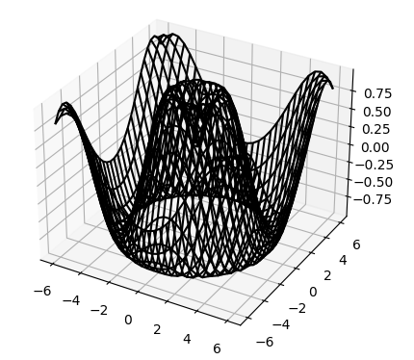
Wireframes and Surface Plots
Wireframes
x = np.linspace(-6, 6, 30)
y = np.linspace(-6, 6, 30)
X, Y = np.meshgrid(x, y)
Z = np.sin(np.sqrt(X ** 2 + Y ** 2))
fig = plt.figure()
ax = plt.axes(projection='3d')
ax.plot_wireframe(X, Y, Z, color='black')
ax.set_title('wireframe')
plt.show()

Slide 73
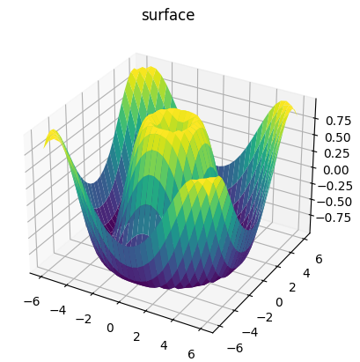
Wireframes and Surface Plots
Surface plots – it is like a wireframe plot, but each face of the wireframe is a filled polygon.
x = np.linspace(-6, 6, 30)
y = np.linspace(-6, 6, 30)
X, Y = np.meshgrid(x, y)
Z = np.sin(np.sqrt(X ** 2 + Y ** 2))
fig = plt.figure()
ax = plt.axes(projection='3d')
ax.plot_surface(X, Y, Z, rstride=1, cstride=1, cmap='viridis', edgecolor='none')
ax.set_title('surface');plt.show()

Slide 74
matplotlib
COMPLAINTS:
Prior to version 2.0, Matplotlib’s defaults are not not so effective in visualization.
Matplotlib’s API is relatively low level. Doing sophisticated statistical visualization is possible, but often requires a lot of complicated code.
Matplotlib is not designed for use with Pandas DataFrames. So a plotting library that can use the DataFrame labels in a plot.

Slide 75
seaborn
Complaints with Matplotlib overcome by Seaborn.
Seaborn provides an API on top of Matplotlib that offers healthy choices for plot style and color defaults
Seaborn defines simple high-level functions for common statistical plot types
Seaborn integrates with the functionality provided by Pandas DataFrames.

